Slide 1

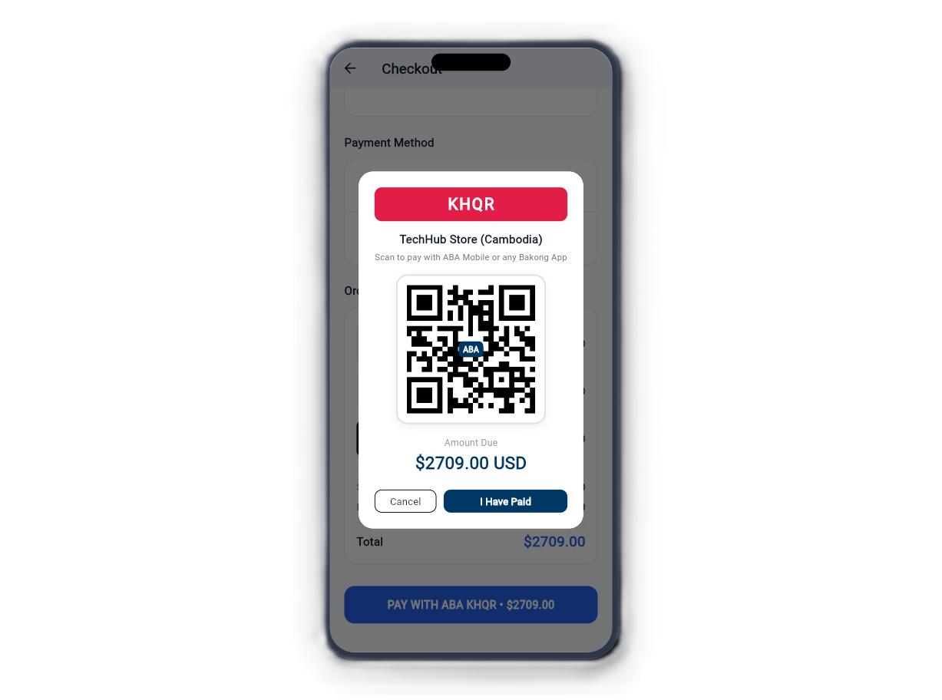
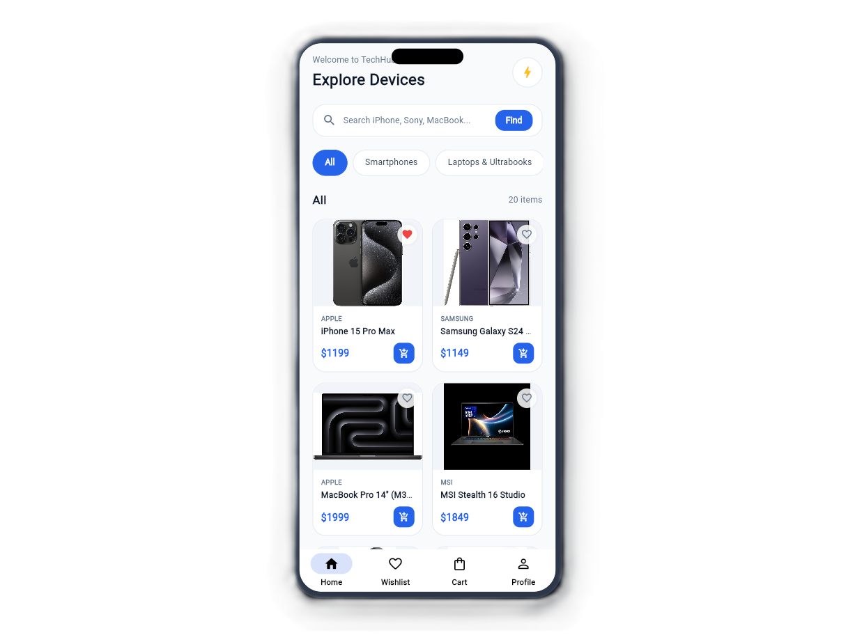
MOBILE APPLICATION · FINAL PROJECT SU25
TechHub Store
Next-generation electronics e-commerce app with smart stock management, ABA KHQR checkout, and live web admin.
Flutter 3
Python Flask
MySQL 8
ABA PayWay KHQR
LECTURER
Ly Lay

Slide 2





Team Members
Core developers contributing across Flutter, Backend API, and Database.
Wan Sokhour
Samun Sreytouch
Run Riya
Kroel Soriya
Sorn Lina
TechHub Store · SETEC Mobile Application SU25
02

Slide 3
Contents
SETEC
Structured roadmap of client application, backend APIs, and database.
01
04–06
02
07–08
03
09–10
Client Mobile Screens
Application Workflows
System Architecture
Catalog, Wishlist, Cart, and KHQR
Login, Cart, and Checkout steps
Flutter to Flask & MySQL connection
04
11–12
05
13–14
06
15–16
REST API Integration
Admin Portal & Dashboard
Database Schema
Endpoints, payloads, and JWT Auth
Inventory, orders, and staff RBAC
Relational structure & foreign keys
07
17–18
08
19–20
09
21
Order & Payment Engine
Bonus & Advanced Features
Q&A and Demonstration
ABA KHQR scan & status update
Live Wishlist, Dark Theme, & Search
Live system checkout test
TechHub Store · SETEC Mobile Application SU25
03

Slide 4
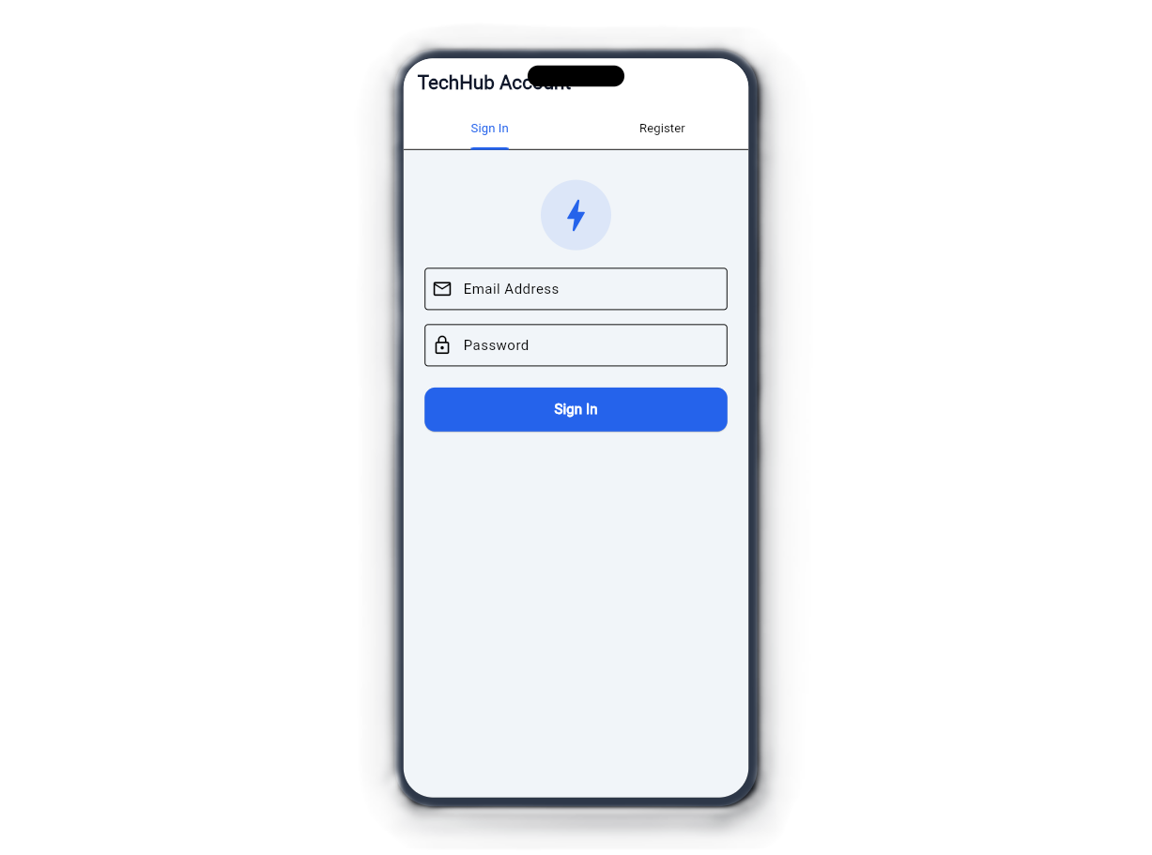
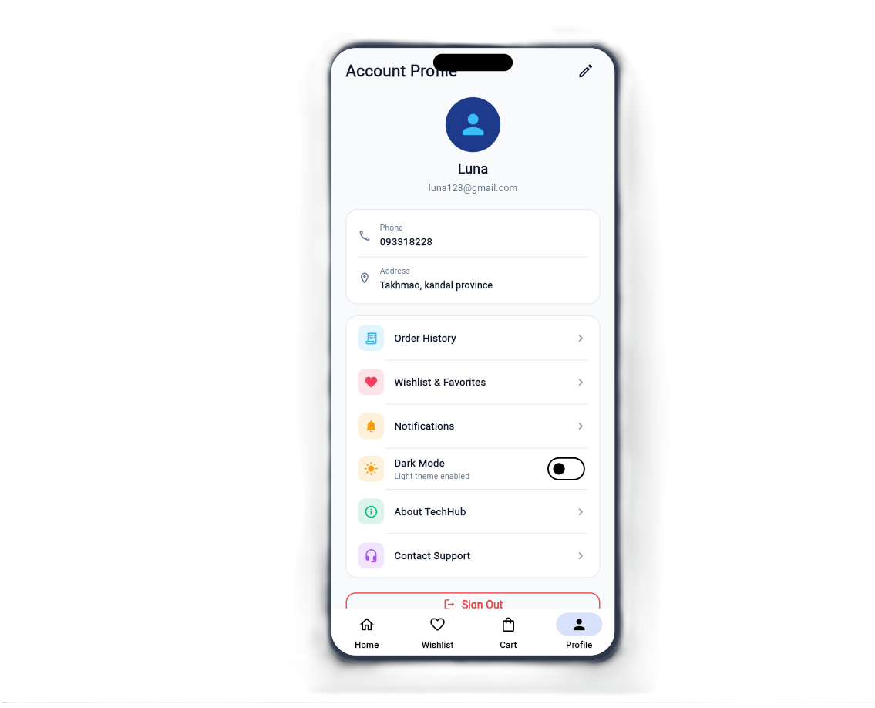
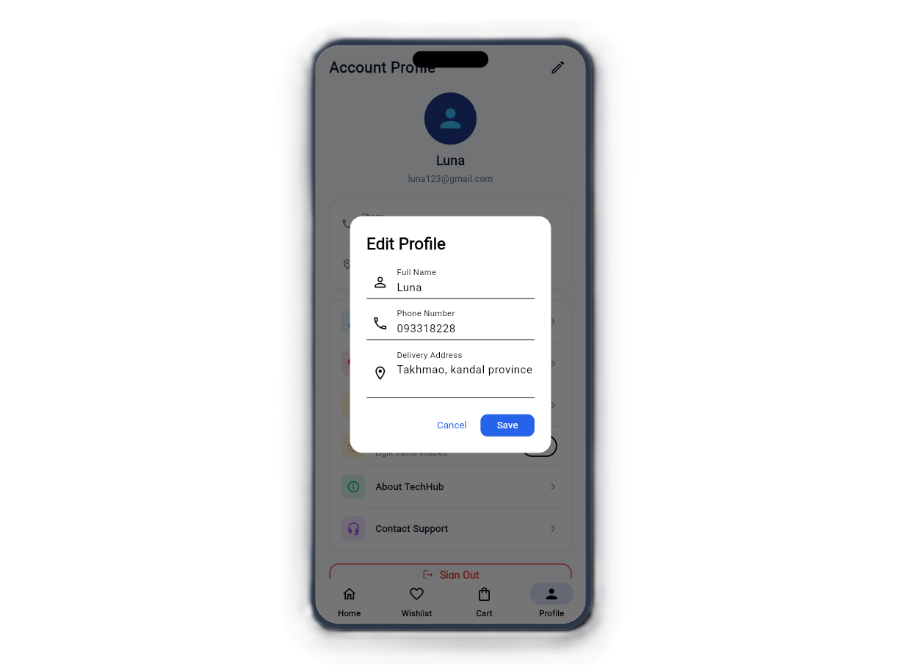
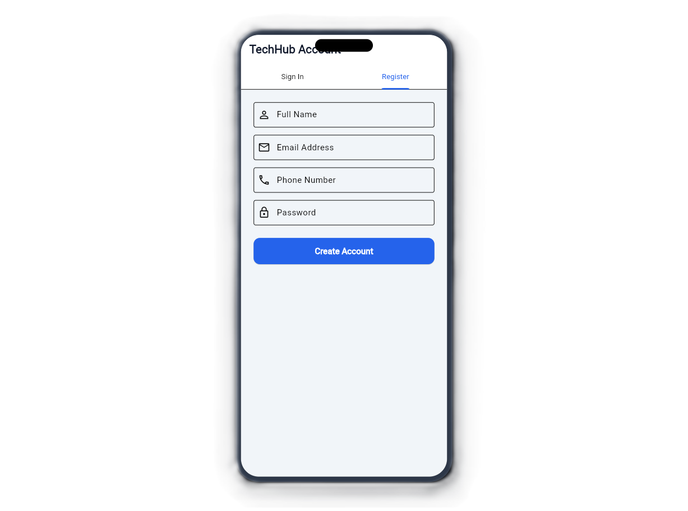
CLIENT DELIVERABLE · PART 1
Account
Log in
Register
Account
Edit Account
TechHub Store · SETEC Mobile Application SU25
04

Slide 5
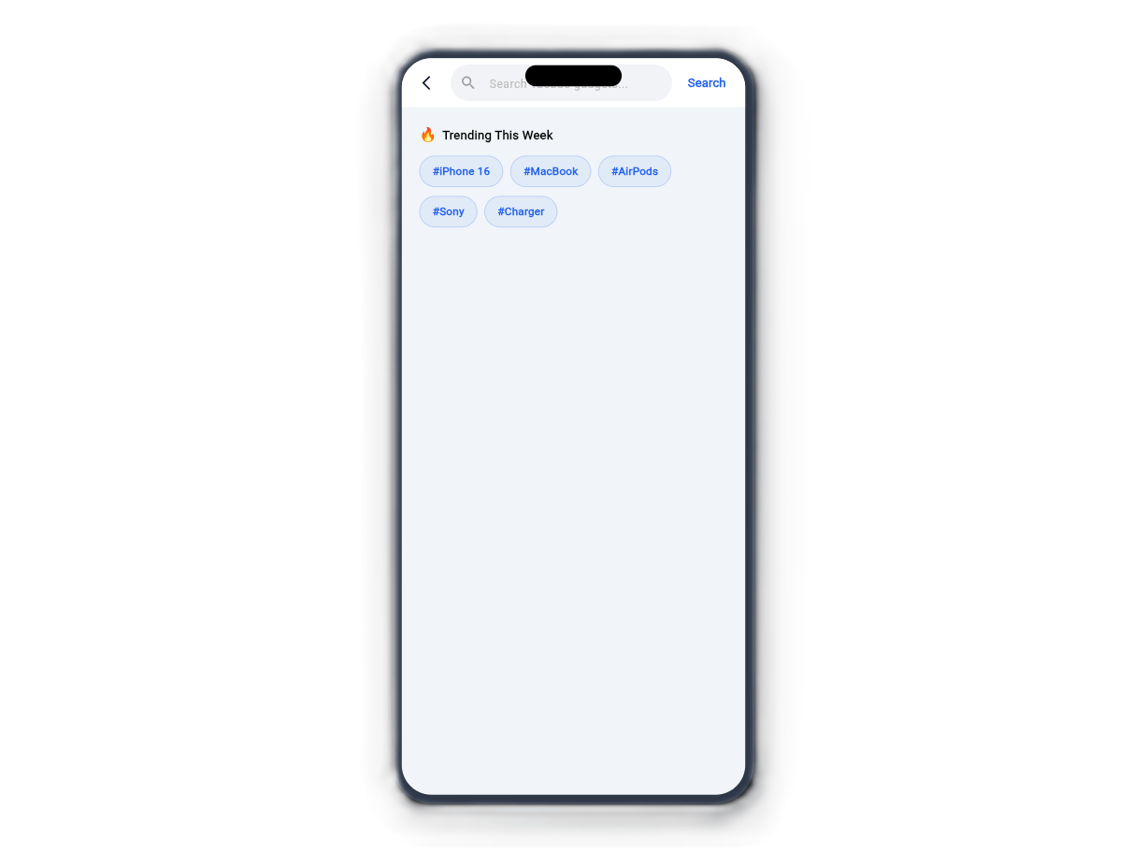
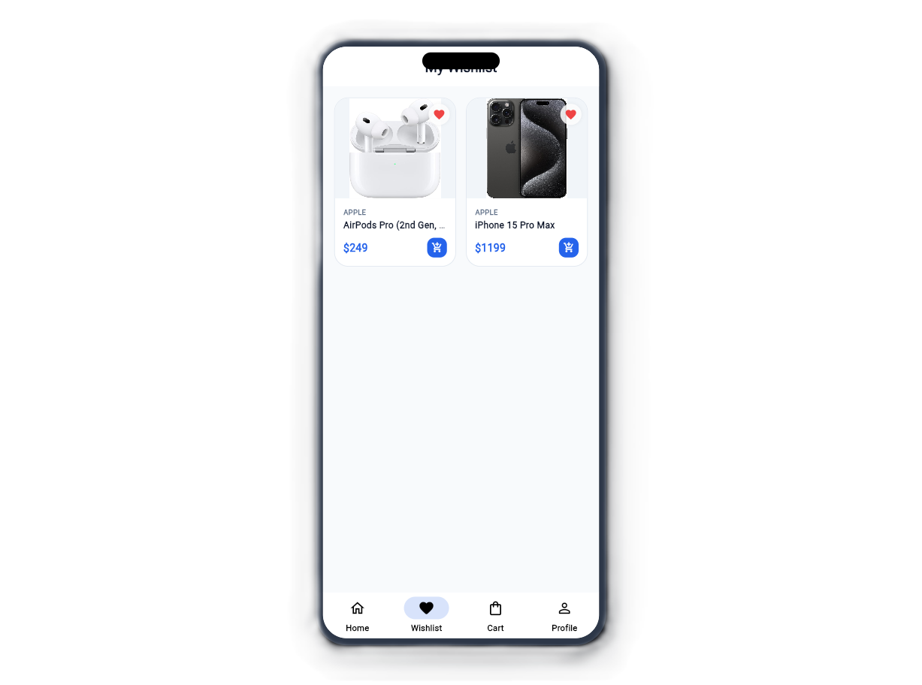
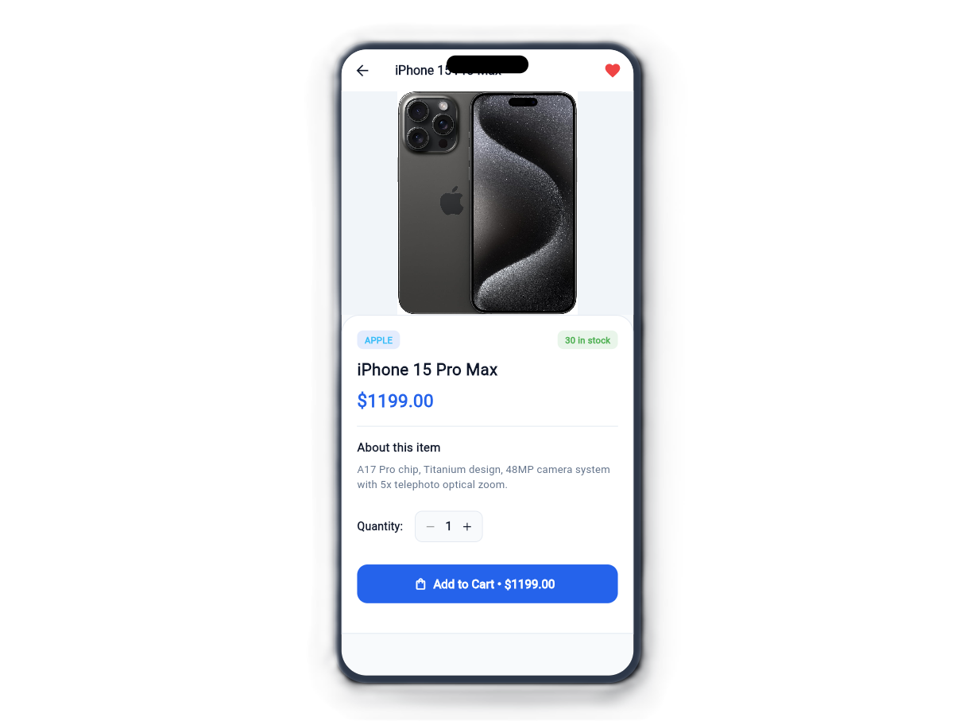
CLIENT DELIVERABLE · PART 1
Store Catalog & Product Details
Home Catalog
Live Search
Product Detail
Favorites Wishlist
Category pills, banner & devices
Real-time SQL query filters
Live stock, specs & quantity
Saved items with instant add
TechHub Store · SETEC Mobile Application SU25
04

Slide 6
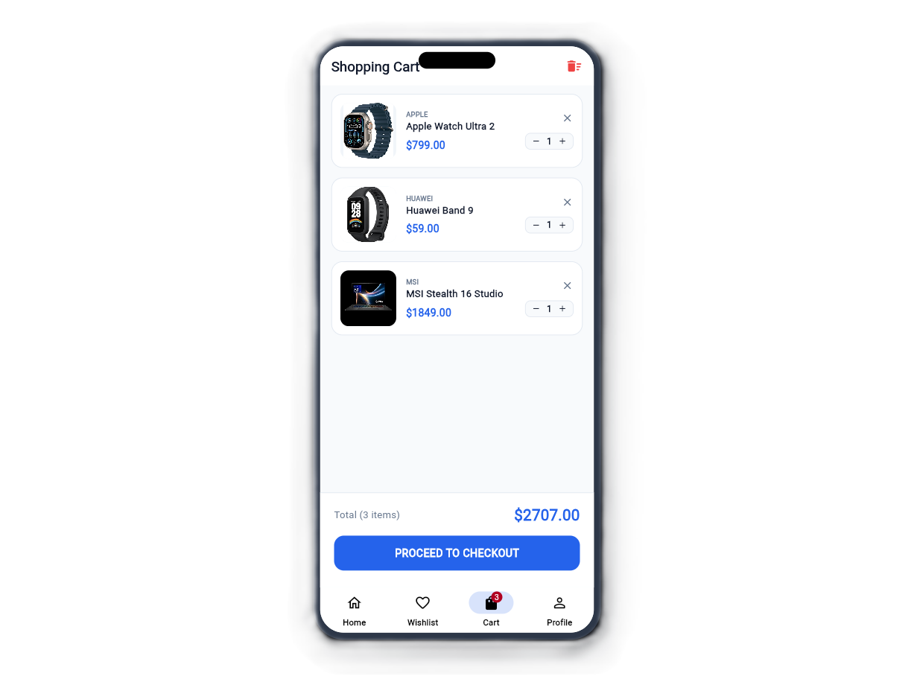
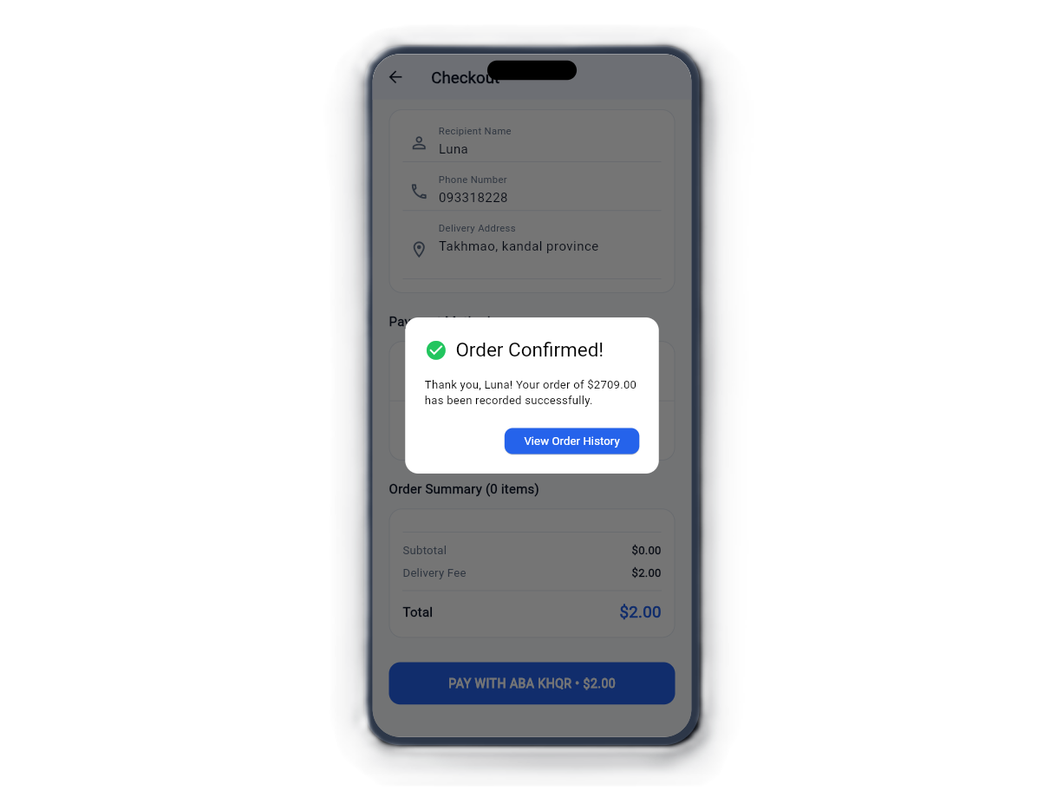
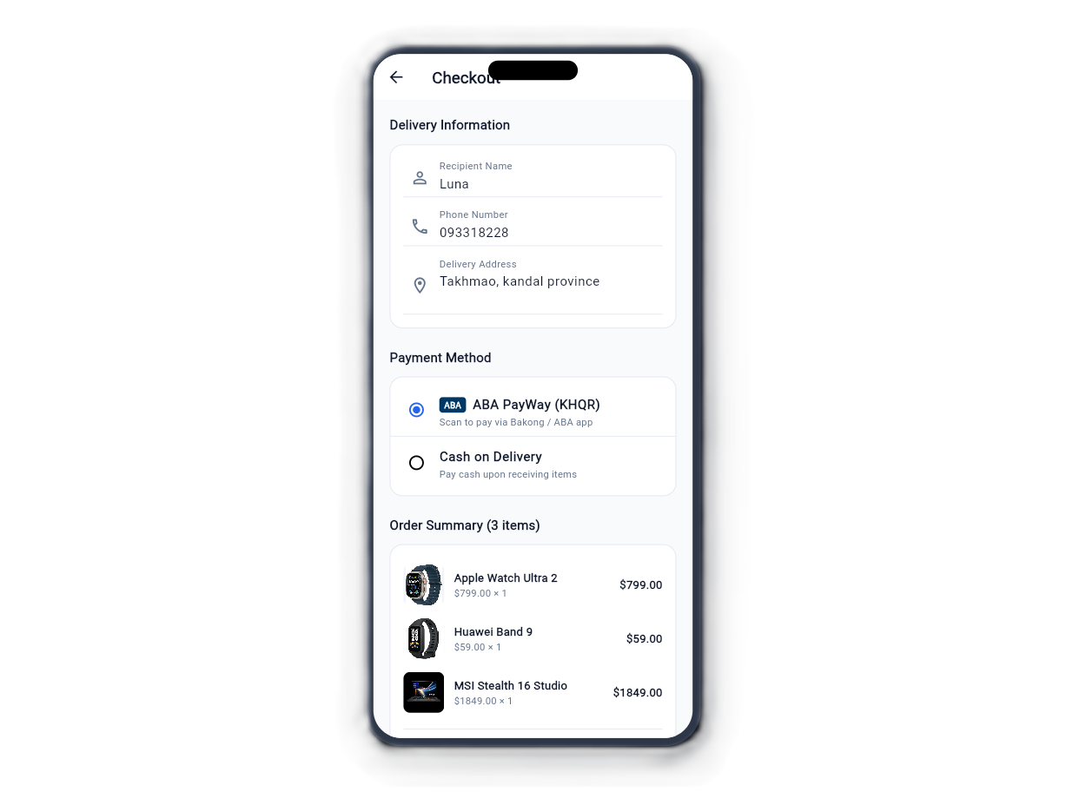
CLIENT DELIVERABLE · PART 2
SETEC
Cart, Checkout & Payment Flow
Cart Manager
Checkout Form
ABA KHQR Modal
Order Receipt
Dynamic calculation & badge
Address validation & delivery fee
Bakong instant QR scan pay
Itemized list & tracking status
TechHub Store · SETEC Mobile Application SU25
05

Slide 7
INTERACTION LIFECYCLE · STEP 1
SETEC
Application Flow 1: Catalog to Cart
FRONTEND · FLUTTER CLIENT
1
3
5
7
Launch & Auth
Browse Devices
Add to Cart
Checkout Screen
Auto-reads stored JWT session.
Filter categories & keyword search.
Local provider calculates subtotal.
Fills recipient & shipping info.
BACKEND · PYTHON FLASK & MYSQL
2
4
6
Validate JWT
Query Products
Check Inventory
Checks bcrypt & expiration token.
SELECT filtered items & image URLs.
Verifies stock >= requested quantity.
TechHub Store · SETEC Mobile Application SU25
06

Slide 8
INTERACTION LIFECYCLE · STEP 2
Application Flow 2: Checkout to Payment
PHASE 01
PHASE 02
PHASE 03
PHASE 04
Submit Order
Database Write
ABA KHQR Modal
Order Receipt
Flutter packages cart payload, delivery fee, and customer info into a POST request to /api/v1/orders/checkout.
Flask initiates atomic SQL transaction: creates order master, records all line items in order_items, and deducts inventory.
If chosen, the app triggers the dynamic ABA KHQR popup displaying store merchant info, exact USD grand total, and QR image.
Cart is cleared automatically; client receives order confirmation dialog and redirects to live status tracking.
Zero Data Leaks: Stock quantities are verified on the backend before order ID assignment.
ATOMIC TRANSACTION
TechHub Store · SETEC Mobile Application SU25
07

Slide 9
SYSTEM TOPOLOGY
How the Parts Fit Together
Flutter Mobile App
TechHub Web Admin
Customer catalog, cart, ABA KHQR & orders
Flask Jinja2 /admin portal with RBAC
JSON over HTTP (REST API & Session Cookies)
Python Flask REST API Server (Port 5000)
PyJWT Authentication · Bcrypt Hashes · MySQL Connector Pool · Multipart File Uploads
MySQL 8 Database (`ecommerce_db`)
InnoDB Engine · Relational Foreign Keys · Encrypted Passwords
TechHub Store · SETEC Mobile Application SU25
08

Slide 10
SERVER COMMUNICATION
REST API & Payload Structure
/api/v1/products
Loads catalog with search
{
"user_id": 1,
"customer_name": "Luna",
"phone": "093318228",
"payment_method": "ABA PayWay (KHQR)",
"amount": 2348.00,
"delivery_fee": 2.00,
"items": [
{ "product_id": 1, "quantity": 1, "price": 1199.00 },
{ "product_id": 2, "quantity": 1, "price": 1149.00 }
]
}
GET
// POST /api/v1/orders/checkout Payload
/api/v1/auth/login
Returns JWT token & profile
POST
/api/v1/orders/checkout
Deducts stock & writes order
POST
/api/v1/wishlist/toggle
Instant favorite toggle
POST
/api/v1/orders/user/:id
Customer order history
✓ Response 200 OK: {"status": "success", "order_id": 20}
GET
TechHub Store · SETEC Mobile Application SU25
09

Slide 11
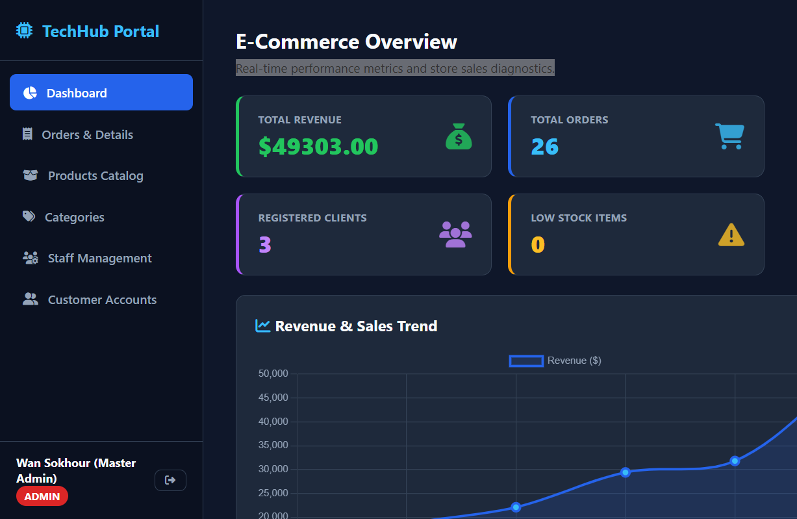
MANAGEMENT SYSTEM
TechHub Web Admin Portal
Revenue & KPI Diagnostics
Real-time sales, order counts, and low-stock alerts.
Order & Receipt Inspector
Modal inspection with customer address & fulfillment status.
Products & Categories CRUD
Instant stock adjustments (+1/-1) and image uploads.
Role-Based Access (RBAC)
Super Admin controls staff credentials & client accounts.
TechHub Store · SETEC Mobile Application SU25
10

Slide 12
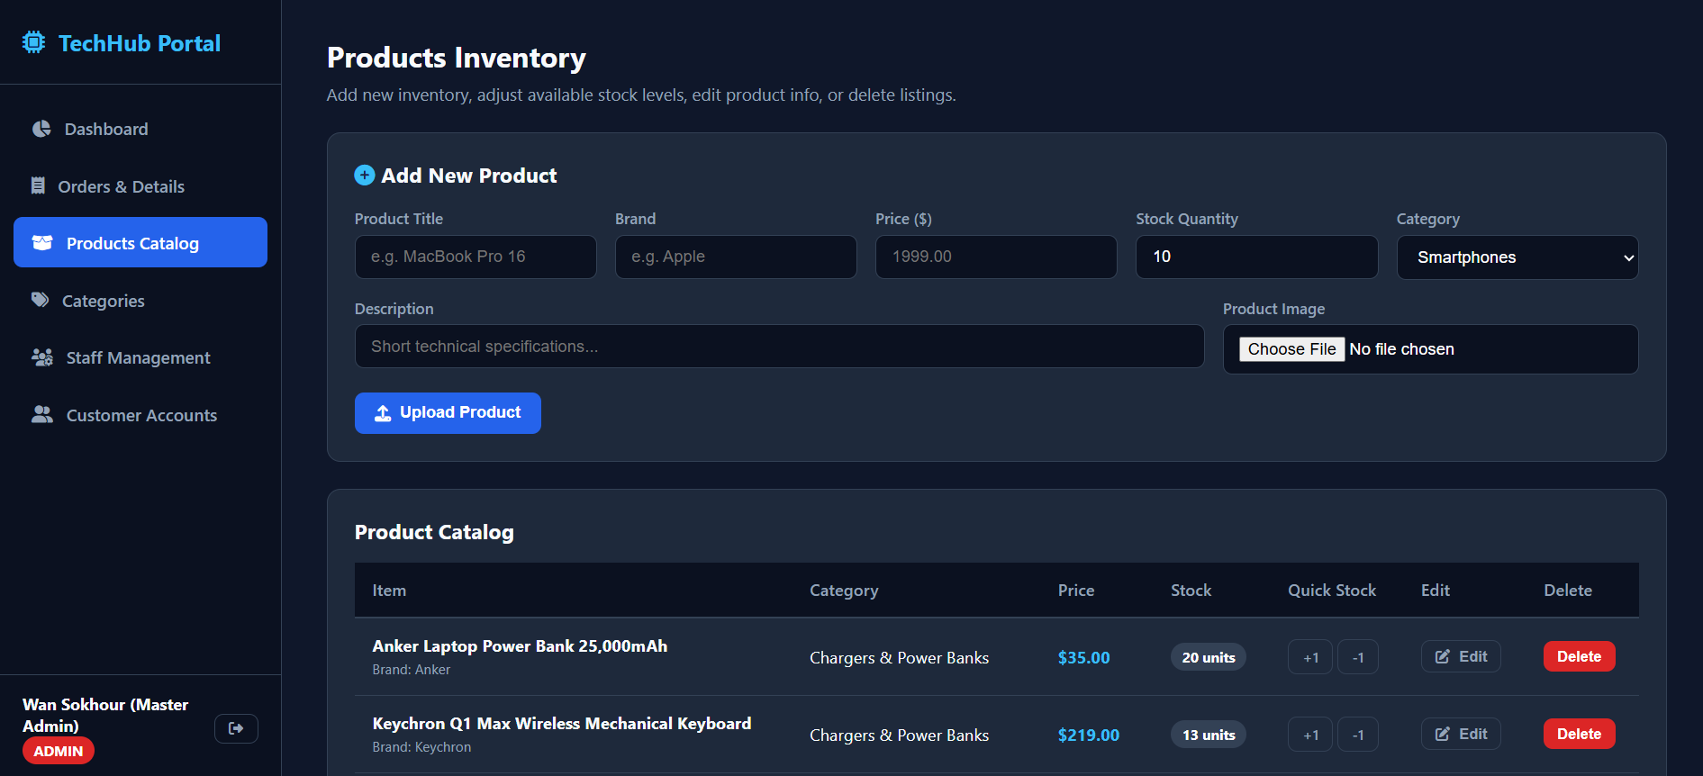
MANAGEMENT SYSTEM
Product
TechHub Store · SETEC Mobile Application SU25
10

Slide 13
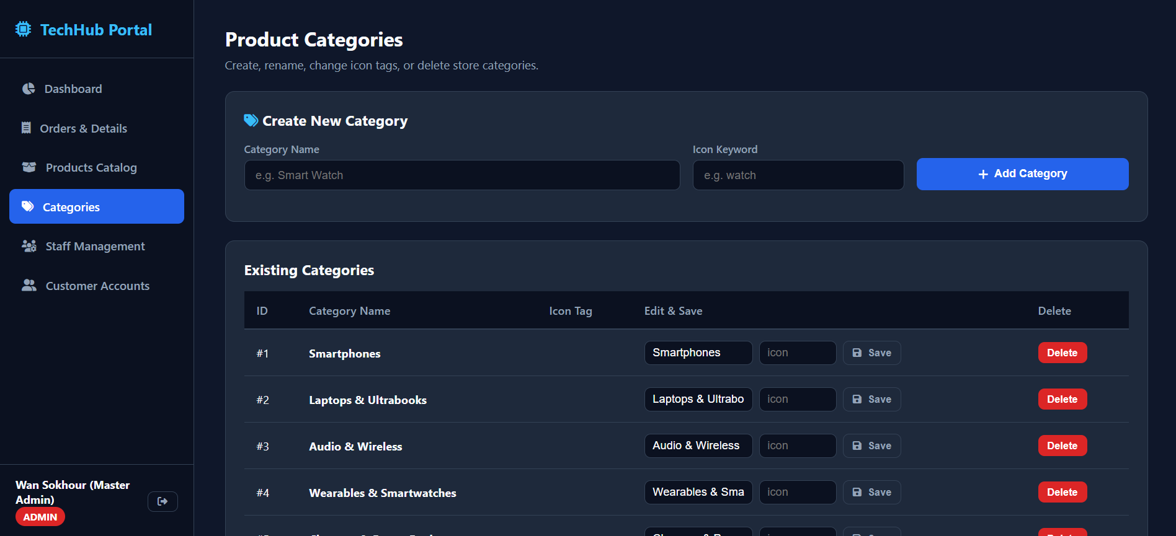
MANAGEMENT SYSTEM
Category
TechHub Store · SETEC Mobile Application SU25
10

Slide 14
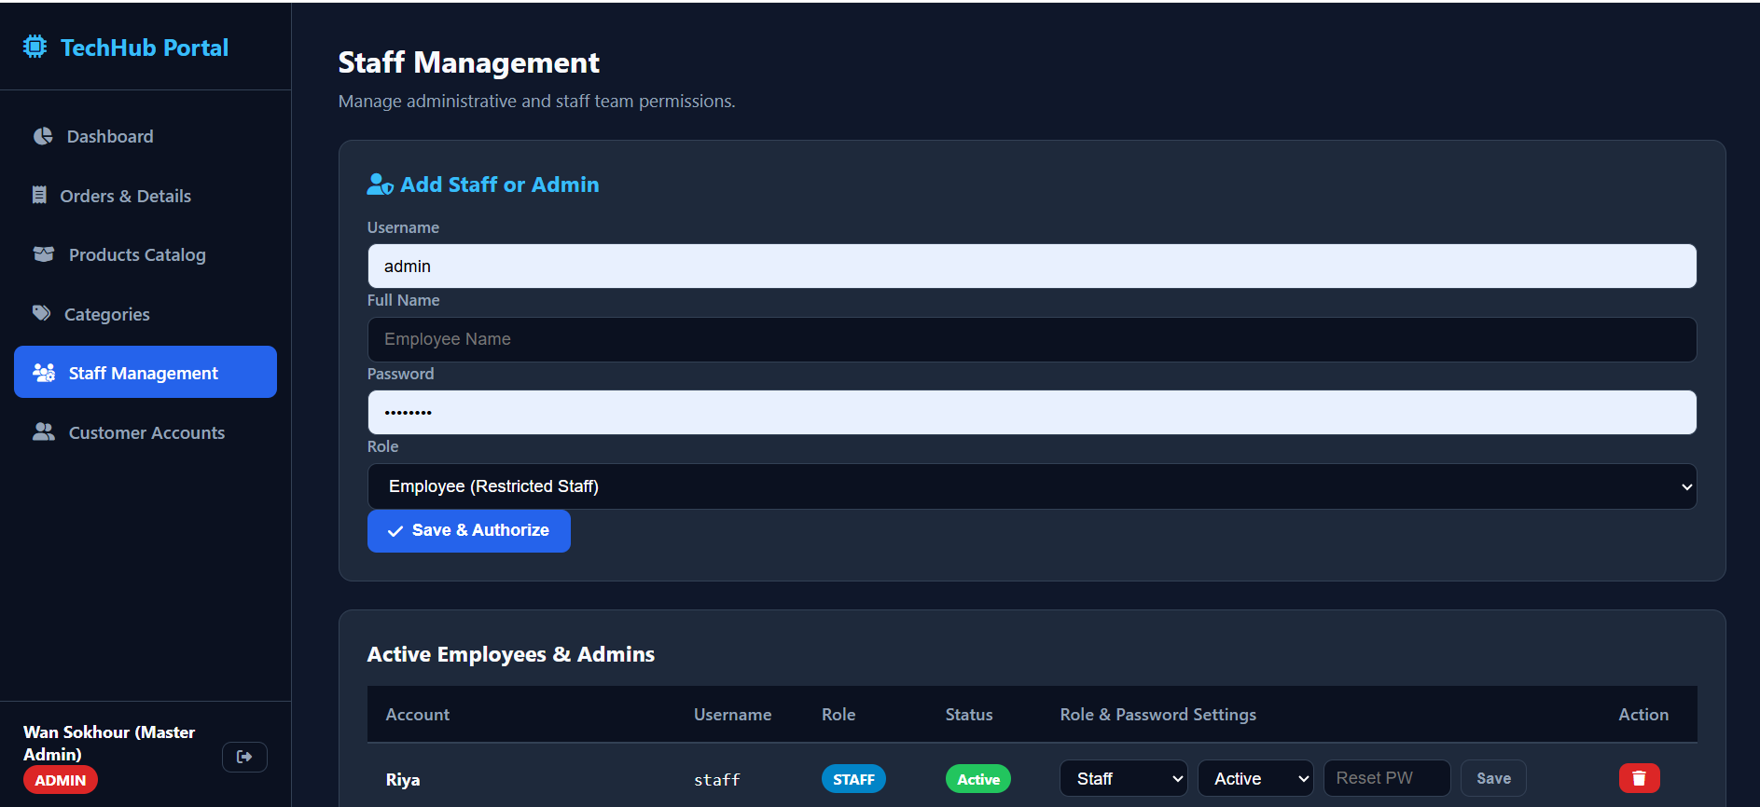
MANAGEMENT SYSTEM
Staff Management
TechHub Store · SETEC Mobile Application SU25
10

Slide 15
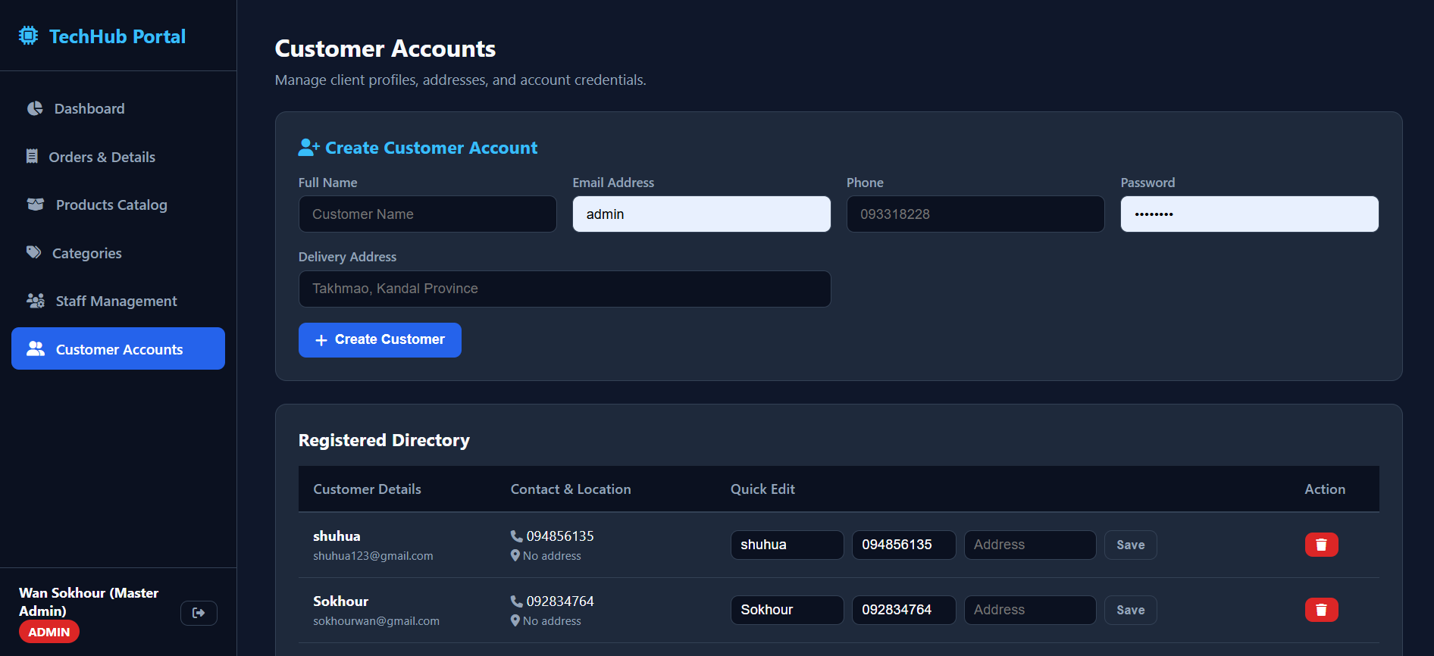
MANAGEMENT SYSTEM
Customer Accounts
TechHub Store · SETEC Mobile Application SU25
10

Slide 16
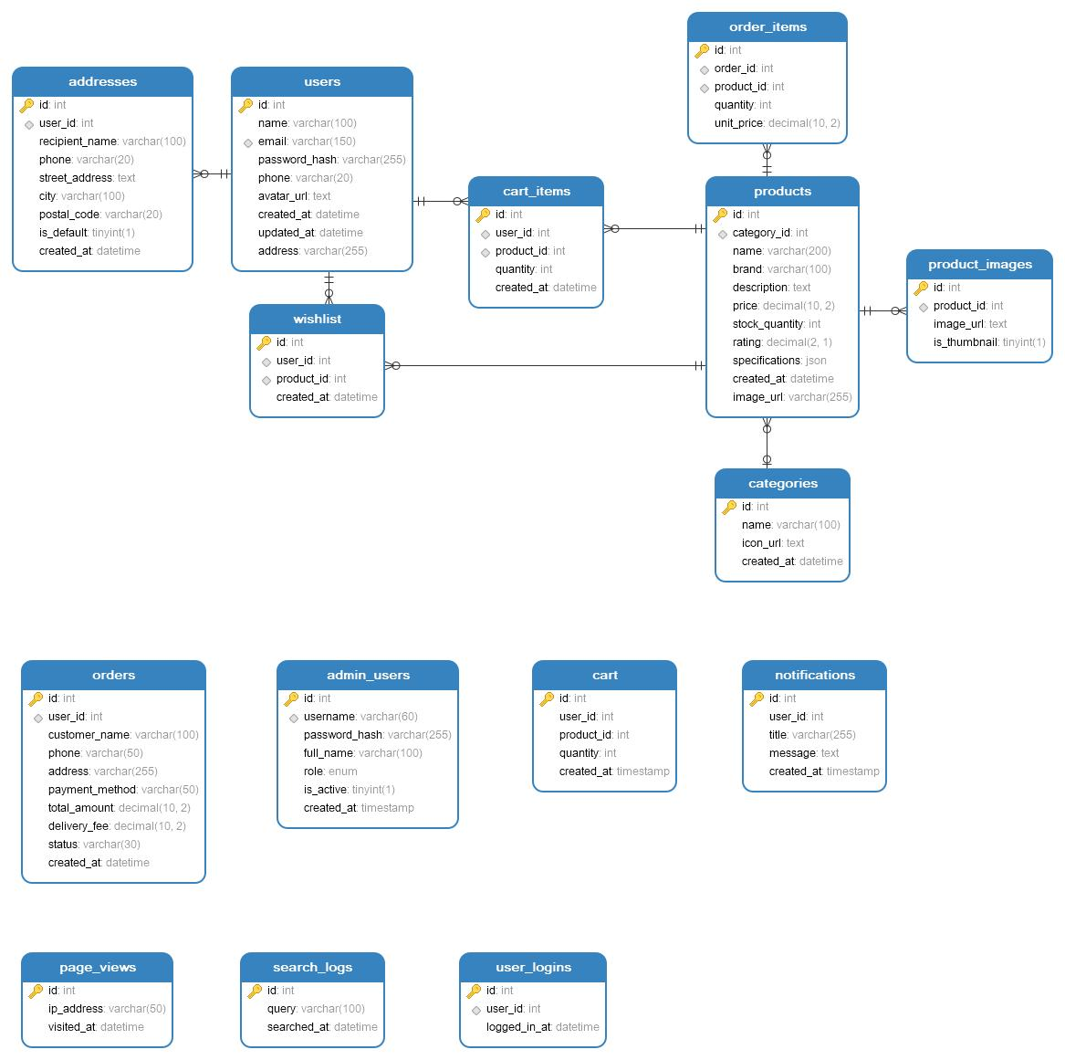
DATA PERSISTENCE
Database Design & Relationships
15
Relational MySQL Tables
InnoDB engine with ACID compliance.
Core Tables:
users: Customer authentication & profile details
products: Name, brand, price & stock quantity
orders & order_items: Relational invoice tracking
categories: Catalog taxonomies with icons
admin_users: Salted bcrypt staff authentication
wishlist: Relational user device favorites
TechHub Store · SETEC Mobile Application SU25
11

Slide 17
SETEC INSTITUTE
·
FINAL PROJECT SU25
Thank You!
We welcome questions, feedback, and live demonstration inquiries regarding TechHub Store.
github.com/SokhourWan/techhub_store_final

